Slide 1

Gaming and Anxiety
Correlation between playstyles and anxiousness
By: Max Song, Joseph Trybala, Miko Wieczorek

Slide 2
Data Introduction: Gaming Habits and Psychological Well-being
~13,000 rows, 55 features.
Several base-level batteries of psychology questions (GAD-7, SPIN-17, SWLS) which measure quantitatively things such as Generalized Anxiety Disorder to Social Phobia to Satisfaction With Life.
Narcissism score
GADE
Biographical data
Age, place of residence, gender, employment, highest earned degree
Self-reported data regarding video game habits
Hours played, time watching streams, game played, platform of choice, competitive tier, single or multiplayer focus, reason for playing, potential earnings from playing
Identifiable biases towards certain groups

Slide 3
Background on GAD-7, SPIN-17, SWLS
GAD-7
The GAD-7, which is an assessment tool for Generalized Anxiety Disorder (GAD) was provided alongside a bonus question: GAD_E, a self-assessment of how anxiety affects an individual with day-to-day life. The GAD-7 consists of 7 main questions that score numerically ranging from 0-3, while the last bonus question is one chosen response (in Likert fashion). Scores for this questionnaire are provided in raw format, a social or psychological practitioner should be able to add the scores to determine true scoring and infer diagnosis based on performance. Ultimately, using the threshold score of 10, the GAD-7 has a sensitivity of 89% and a specificity of 82% for GAD. Moreover, it’s also moderately good at screening three other common anxiety disorders – panic disorder (sensitivity 74%; specificity 81%), social anxiety disorder (sensitivity 72%; specificity 80%), and post-traumatic stress disorder (sensitivity 66%; specificity 81%).
SPIN-17
The Social Phobia Inventory (SPIN) was administered to participants in this study and the scores were recorded as raw values. SPIN is normally administered as a 5-question battery, the version used for this study was SPIN-17 which is an extended battery. The extended SPIN questionnaire consists of 17 questions whose scale is rated over the past week and address each of the symptom domains of social anxiety disorder (e.g., fear, avoidance, and physiological arousal). The total SPIN score is calculated by summing all of the individual scores from each question. A score of 19 and above appears to suggest a possibility of social anxiety; the possible range is between 0 and 68.
SWLS
The Satisfaction With Life Scale (SWLS) is a 5-question assessment tool that is designed to measure global cognitive judgments of one’s own life satisfaction. Recipients of this questionnaire indicate how much they agree or disagree with each of the five questions, using a 7-point scale, ranging from “Strongly Agree” (7) to “Strongly Disagree” (1). Each gamer’s own judgments of their own life satisfaction are scored by adding each individual score for every question, totaling a sum of categories that range from “Extremely Satisfied” to “Extremely Dissatisfied.” The questions are designed in a way that, although not specific to areas of life such as finance or health, allow the gamer to integrate and weight their life areas in a way that suits them, when assessing each statement.

Slide 4
How we modified/cleaned it
Binning of total scores on GAD-7, SPIN-17 based on field accepted thresholds.
If a score would have led a professional to assume a mild case of anxiety for GAD we categorized that total score as Mild.
If an individual has a high enough score on SPIN to have been labeled as having social phobia, they earned a binary social phobia label.
Feature engineering: Creating features based off total scores & thresholds (GAD, SPIN, SWLS)
Binary Features:
anxiety_binary: None/Mild = 0; Moderate/Severe = 1 (from GAD)
social_anxiety: None = 0; (Mild, Moderate, Severe, Very Severe) = 1 (from SPIN)
Categorical Features:
‘anxiety’: None < Mild < Moderate < Severe (from GAD)
social_phobia: None < Mild < Moderate < Very Severe < Severe (from SPIN)
life_satisfaction: Extremely Satisfied > Satisfied > Slightly Satisfied > Neutral > Slightly Dissatisfied > Dissatisfied > Extremely Dissatisfied (from SWLS)
Combined Target
Numeric Features
Age
Narcissism
Combination of Categorical Features
Earnings > Play for fun vs other
Playstyle > Single vs Multi vs Other
Residence > USA GR UK CA, Other
Work > Student Employed Unemployed
Degree > Highscool College
After preliminary work
SelectKBest for Feature Selection

Slide 5
Which models did we choose/why?
Logistic Regression (LR) - Logistic Regression is an easy choice for a baseline analysis, in our group's experience it does surprisingly well given the simplicity and efficiency.
Random Forest (RF) - With the ability to find feature importance and handle imbalanced, non-linear, data we thought that RF would do a good job with various self-describe features in the dataset.
Support Vector Machine (SVM) - SVM’s are powerful and our data does not fully utilize the capabilites they afford. We chose the model based on familiarity. Figuring that due to our data’s limited size the time crunch required by SVM would not be an issue, while potentially providing the best accuracy of the models available. If we were to proceed in making an ensemble model an SVM would be a good choice to alloy with Random Forest due to the difference in methodology.
Notes:
Naive Bayes (NB) – Due to its efficiency and speed in handling large datasets, it’s a great alternative for evaluating our data since it can also handle missing data and is probabilistic in nature (providing probabilities of the outcomes). It is also capable of and naturally suited for multi-class predictions as well, if we needed such capacity.

Slide 6
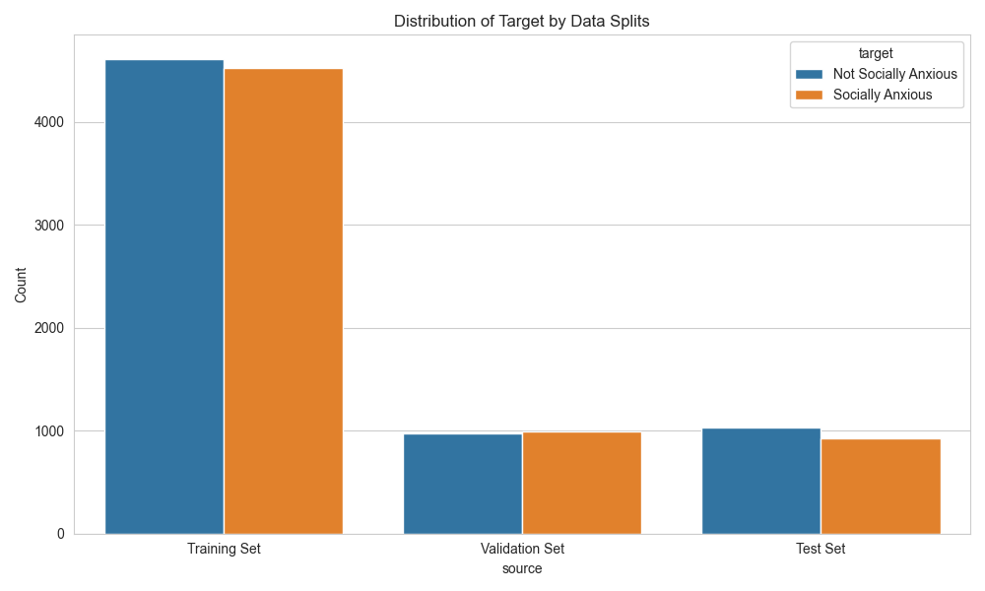
Data Splits & Target Distribution
Size
13,058 rows, 25 columns not including target
Balance on Combined Target
Negative Diagnosis on GAD and SPIN 6,815
Positive Diagnosis on GAD and/or SPIN 6,592
Train/Validation/Test – 70/15/15

Slide 7
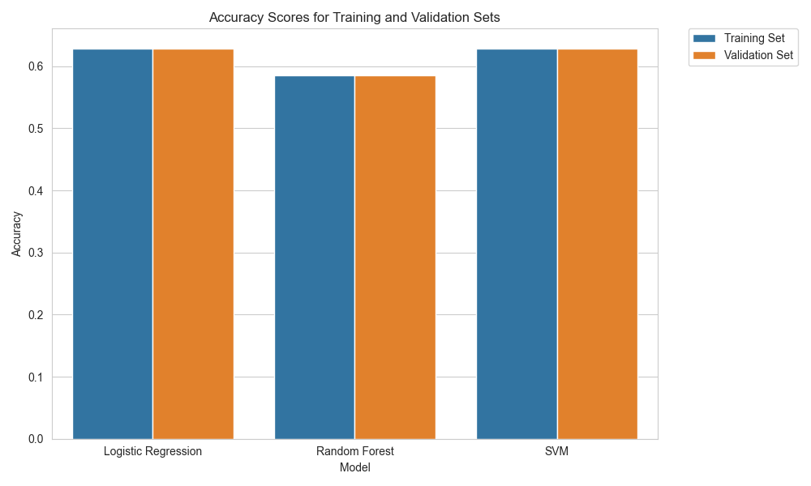

Exploratory Modeling (without tuning)
Accuracies around ~60%
No overfitting visible (yet)
Feature selection as we move into hyper-parameter tuning (Select-10-Best)
Notes:
We decided to use a Select-K-Best method to reduce the number of our features from 25 to 10 best features
We used the F-values computed via the ANOVA (Analysis of Variance) test with respect to the target variable
It’s commonly used as a feature selection method however its limitations are the ANOVA assumptions

Slide 8
Evaluation on Validation Set: Performance by Model
Model | AUC | Accuracy | Precision | Recall | Best Params
LogisticRegression | 0.641 | 64.11% | 65.02% | 62.59% | {'C': 0.01, 'max_iter': 100, 'solver': 'newton-cg'}
RandomForest | 0.639 | 63.86% | 64.65% | 62.69% | {'bootstrap': False, 'max_depth': 10, 'min_samples_leaf': 4, 'min_samples_split': 10, 'n_estimators': 10}
SVM | 0.642 | 64.17% | 65.38% | 61.68% | {'C': 1, 'gamma': 0.001, 'kernel': 'rbf'}
Results from Grid Searches
All 3 models perform similarly
Logistic Regression is most interpretable
Notes:
After conducting grid searches,
None of the models are performing exceptionally well, with AUCs close to 0.64, indicating only a moderate ability to differentiate between the classes.
the performance of the Logistic Regression model closely matches that of the SVM with an RBF kernel.
Trade-offs: The Logistic Regression and RandomForest models have a slightly better recall, meaning it is less likely to miss cases of social anxiety. In contrast, the SVM has better precision, meaning it is less likely to incorrectly predict social anxiety. Depending on the cost of false positives vs. false negatives in your use case, you might prefer one model over the others.
Slightly higher recall is particularly important in our use case. This advantage is underscored by the fact that missing a person with social anxiety carries a higher cost than misclassifying someone as having social anxiety
However, in the end, the Logistic Regression model offers superior interpretability due to its direct access to coefficients.
That’s why we decided to include that as our best final model and evaluate it on the test set

Slide 9
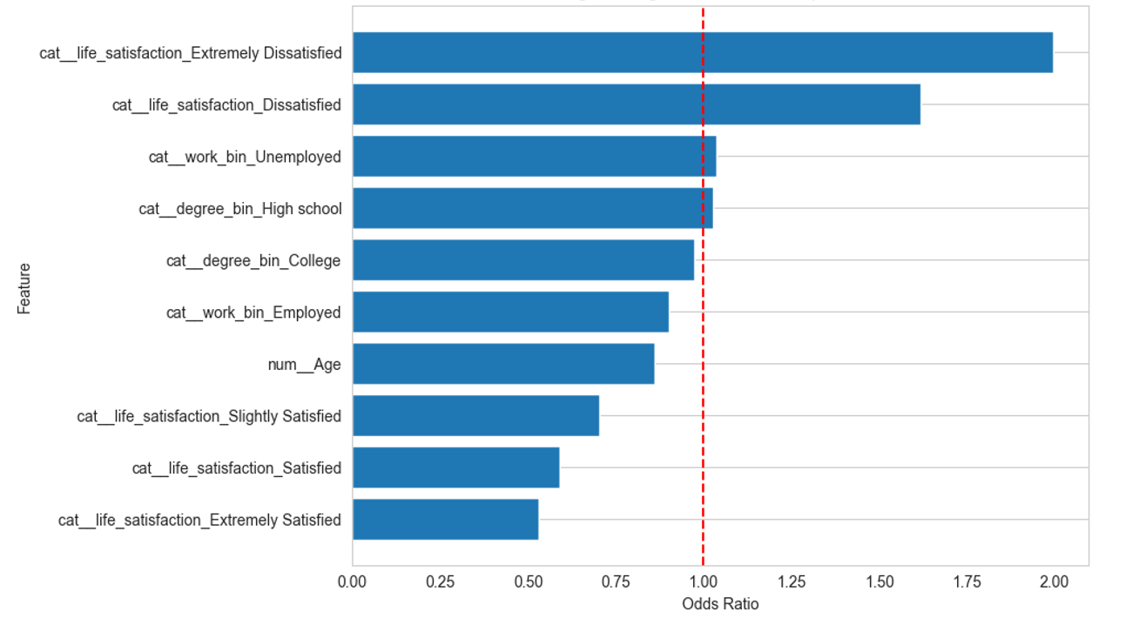
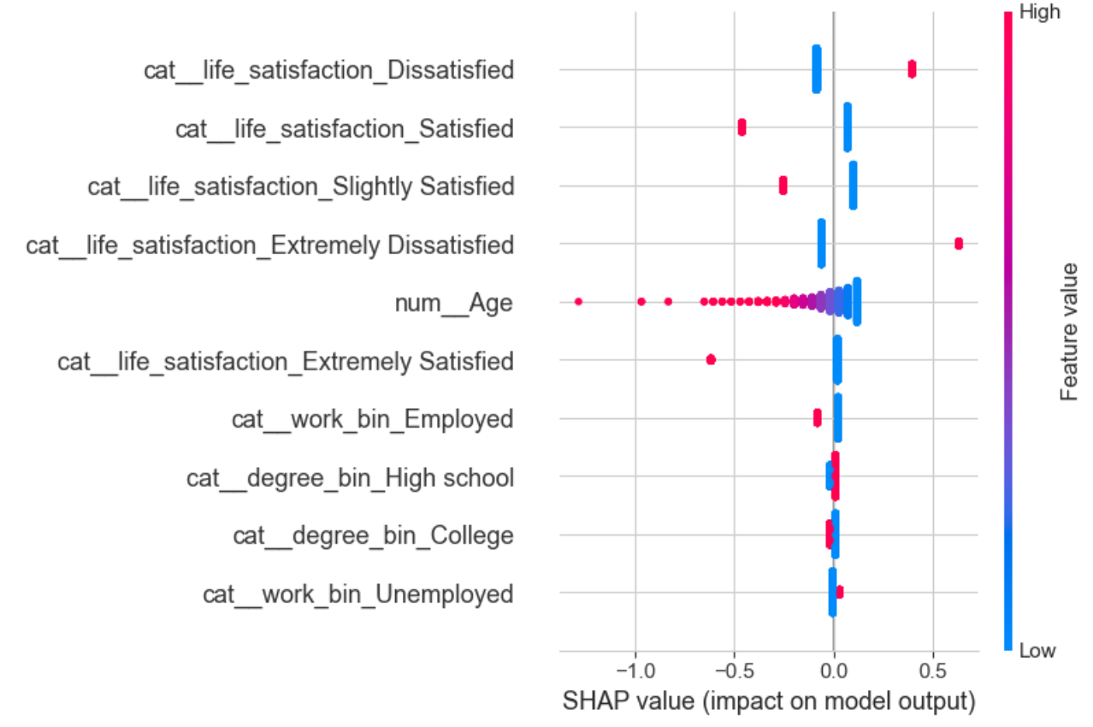
Evaluation on Test Set: Best Logistic Regression Model
Feature Importance
Consistency between model’s Odds Ratios and SHAP explainer
Life satisfaction features have a strong predictive power regarding social anxiety
Age has a cluster of SHAP values around 0 → not a significant impact
SHAP Summary Plot on Validation Set
Notes:
Right hand side
Variable importance plot using the odds ratios (which are exponentiated coefficients)
The number above 1 tells us players are more likely to be socially anxious with one unit increase in that feature. The opposite goes if odds ratios are below 1
Mention:
If you are Extremly Dissatisdied according to the Life satisfaction assemssment, you are about twice as likely to be socially anxious
Or if you are an Employed gamer, you are 10% less likley to be socially anxious
SHAP values represent the impact of each feature on the model's output. A SHAP value shows how much a given feature changes the prediction from the baseline prediction
The color represents the value of the feature (red for high, blue for low). For instance, high levels of life satisfaction (red dots) shift the prediction to the right (increasing the likelihood of being socially anxiou
the spread of the dots shows the range of the impacts. Wider spreads mean the feature has a more variable effect on the predictions
For example, age has a cluster of SHAP values around 0, meaning it has a less significant impact on the prediciton

Slide 10
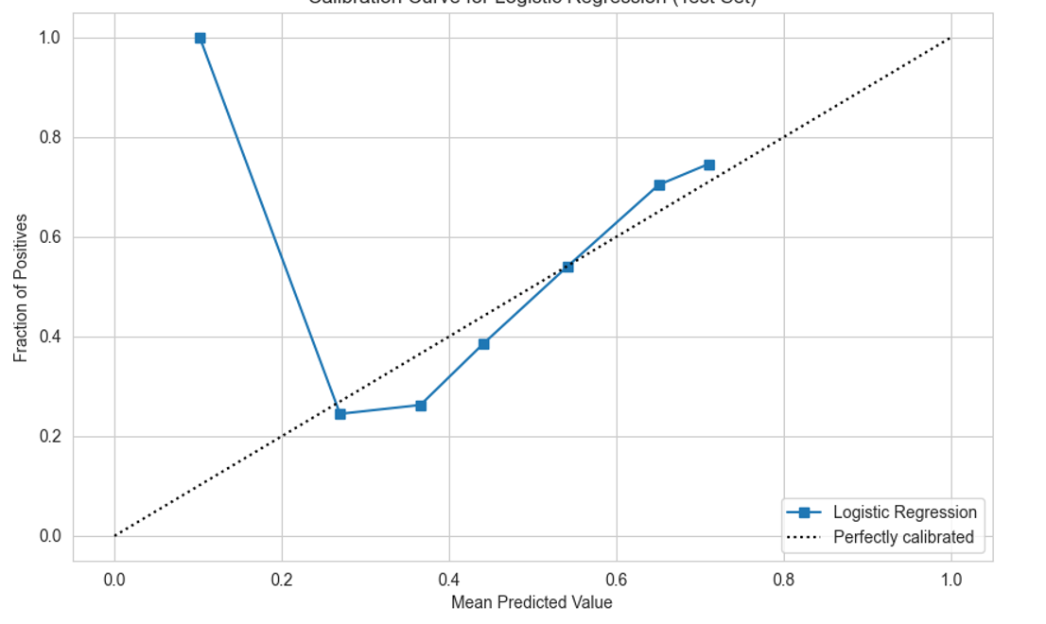
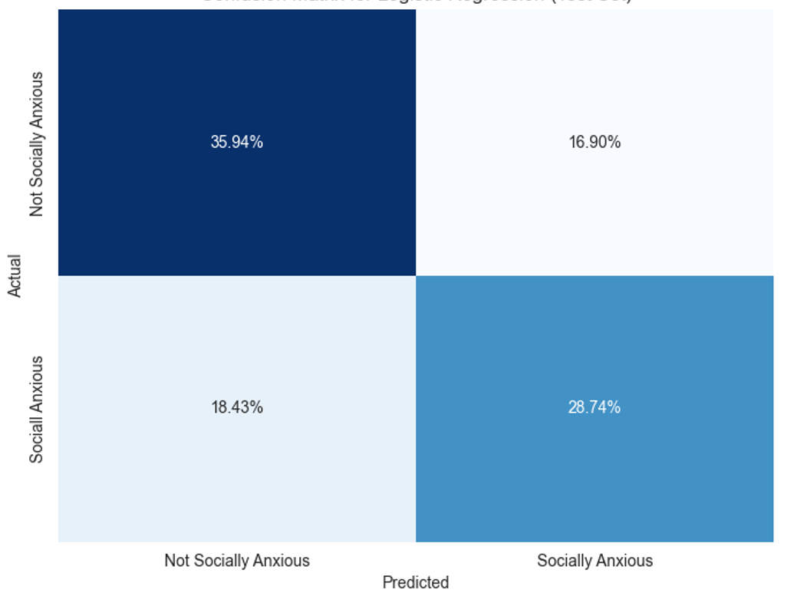
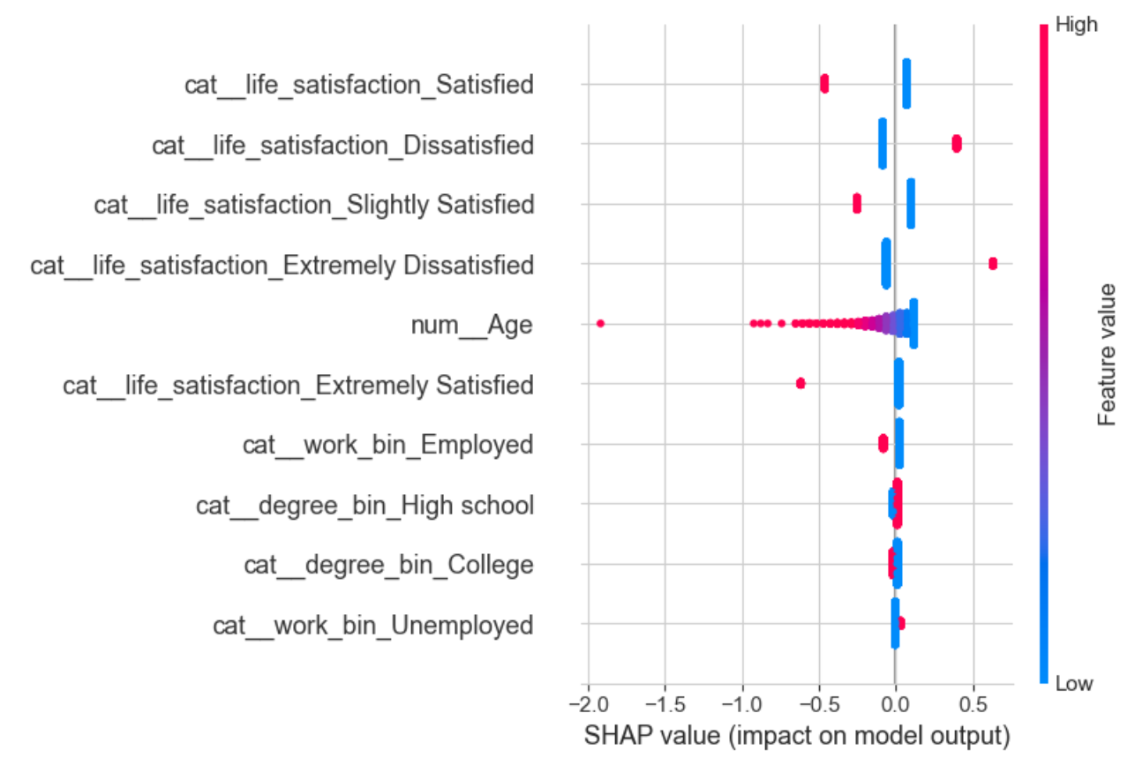
Evaluation on Test Set: Best Logistic Regression Model
The model may be underconfident in its predictions for the lower predicted probabilities and overconfident for the higher predicted probabilities
Under the threshold of 0.5, our model still has a high proportion of False Positives (17%)
Might lower the threshold to increase the sensitivity of the model
Calibration Curve
Confusion Matrix (threshold=0.5)
SHAP Summary Plot on Test Set
Notes:
The calibration curve provides a way to evaluate whether the predicted probabilities of a model are indicative of the actual outcome probabilities.
About the calibration plot: the x-axis represents the average predicted probability of the logistic regression model for each bin of instances. It is divided into n_bins, which in your case is 10. Each bin contains a subset of the prediction probabilities for your test set, which are averaged to find the point on the X-axis
The y- axis shows the actual fraction of socially anxious gamers in each bin
These squares represent the calibration of the logistic regression model across different bins. For each bin, we plot the mean predicted value against the actual fraction of positives in that bin
Interpretation:
if the blue squares (model calibration) are close to the dotted line (perfect calibration), the model's predicted probabilities are close to the true probabilities
The shape of the logistic regression line suggests that the model might benefit from recalibration. The model tends to underestimate the probability of being socially anxious when the predicted probability is low and overestimate when it's high.
Overall, the data suggests that life satisfaction categories are the most influential factors in predicting social anxiety, with employment status and education also being important but to a lesser extent. Age doesn't seem to be as strong a predictor in this model.

Slide 11
Conclusion of the work, limitation and future work
Conclusion
Low-Moderate Performance
Life satisfaction measures are most significant
Odds Ratios enhanced interpretability
Limitation
Data was unclean and imbalanced. A larger sample collected through means other than just Reddit is desired.
Future work
Find general psych data with which to compare. Does gaming correlate overall to increased cases of anxiety?
Properly approach leagues feature with a comparative table. Could identify if high-level vs low-level play is correlative.

Slide 12

Workload distribution
Through the united strength of our comradeship, each of us has equally borne the weight of our collective endeavor
Modeling
Max, Miko, Joe
Presentation
Max, Miko, Joe

Slide 13
References and Sources
Dataset
https://www.kaggle.com/datasets/divyansh22/online-gaming-anxiety-data/data
Original Provenance: https://osf.io/vnbxk/
GAD-7
https://www.phqscreeners.com/images/sites/g/files/g10060481/f/201412/GAD-7_English.pdf
SPIN-17
KM Connor, et al. Psychometric Properties of the Social Phobia Inventory (SPIN): New Self-Rating Scale. British Journal Psych. 2000.
SWL-5
https://fetzer.org/sites/default/files/images/stories/pdf/selfmeasures/SATISFACTION-SatisfactionWithLife.pdf
SINS-1
https://dx.plos.org/10.1371/journal.pone.0103469

Slide 14
Mandatory Thank You Slide

